Slide 1
SOLAR TRACKER
PRESENTED By :
AKASH.A(22AI001)
SANTHOSH RAJ.P(22AI047)
SHARATH.R(22AI049)
Guided By :
Dr.K.Lalitha
TEAM NO: 1
22AIC14 & INTERNET OF THINGS AND ITS APPLICATIONS

Slide 2
Abstract:
The solar tracking system rotates solar panels to follow the sun’s path, increasing energy capture by keeping the panels aligned with sunlight throughout the day.
Unlike fixed-position panels, this system automatically adjusts the angle of the panels to face the sun, maximizing sunlight exposure and energy efficiency.
The design is simple and does not use remote control, IoT, or any form of monitoring—just automatic rotation based on sunlight detection.

Slide 3
Objectives:
Maximize Solar Energy: Increase energy capture by keeping the panel aligned with the sun.
Simple, Standalone System: Avoid remote control and IoT, focusing solely on solar tracking.
Efficient Use of Power: Only use power for rotating the panel, minimizing energy usage.

Slide 4
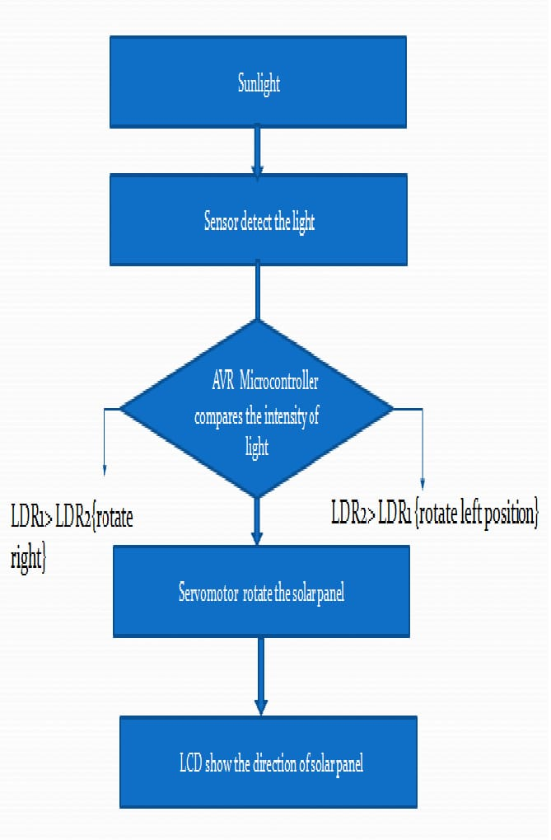
Flow Diagram:

Slide 5
Components:
Microcontroller: A basic controller like Arduino to handle sensor readings and motor control.
Servo Motor: Rotates the solar panel horizontally to follow the sun.
Power Supply for Arduino: Provides the necessary voltage to power the Arduino and connected components.
LDR (Light Dependent Resistor): Senses the intensity of sunlight and helps adjust the solar panel's direction.
Connecting Wires: For linking the components together.
Small Solar Panel: The prototype panel, which will be adjusted to track the sun’s position.
1k Resistor: Likely used with the LDR for signal stabilization in the sensor circuit.

Slide 6
Implementation:
Setup: Connect the microcontroller to the LDR sensors and the motor. Position two LDRs on opposite sides of the solar panel to detect sunlight from different angles.
Programming: Program the microcontroller to read data from the LDRs. When one LDR detects more light than the other, it sends a signal to the motor to rotate the panel towards the light.
Control Logic: Set a threshold difference in light intensity between the two LDRs. When the difference is detected, the motor slightly rotates the panel to align with the brighter side.
Testing: Test the system to ensure it correctly rotates toward the sun, making any adjustments needed to improve alignment.

Slide 7
Conclusion:
This project shows that using LDR sensors to track sunlight can significantly improve the energy output of solar panels.
The system is cost-effective, easy to implement, and helps make better use of solar energy. It is a practical solution for homes, businesses, and large solar farms.
In the future, the system can be improved with advanced technologies to make it even more accurate and efficient.

Slide 8
Thank You

